Slide 1
Dictionary (map) and Hashing
J.Govindarajan, Asst.Prof. (Sr.Gr) , CSE

Slide 2
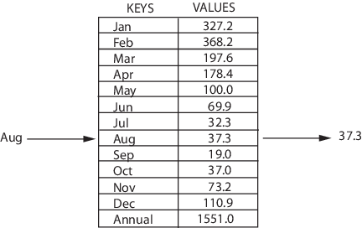
Map
A map is an abstract data type designed to efficiently store and retrieve values based upon a uniquely identifying search key for each.
Map stores keyvalue pairs (k,v), which is called as entries
Also known as associate array (using entry’s key serves as index. Key need not be numeric.)

Slide 3
Map : Applications
A university’s information system relies on some form of a student ID as key
domain-name system (DNS)maps a host name, such as www.wiley.com, to an Internet-Protocol (IP) address, such as 208.215.179.146
A social media site typically relies on a (nonnumeric) username as a key
A company’s customer base may be stored as a map
A computer graphics system may map a color name to RGB numbers

Slide 4
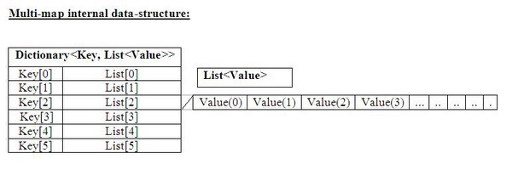
Multimap ADT
Allows multiple entries to have the same key
Multimap to contain entries (k,v) and (k,v′) having the same key

Slide 5

Dictionary
Models a searchable collection of key-element items
Multiple items with same key allowed
Main operations include
insertion, searching, and deleting
Applications
– Telephone directory
– Mapping student info to roll nos

Slide 6
Dictionary : ADT
find(k):
if the dictionary has an item with key k, returns the position of this item, else, returns a null position.
insertItem(k, o):
inserts item o with key k into the dictionary
removeElement(k):
removes the item with key k from the dictionary. Exception of no such element.
Other functions
– size(), isEmpty()
– keys(), Elements()

Slide 7
Dictionary
Types
– Ordered Dictionaries
A total order relation is defined on the keys
– Unordered Dictionaries
No order relation is assumed on the keys
Only equality testing between keys is used
Associative Stores
– When keys are unique, keys are like addresses to the location where the element is stored

Slide 8
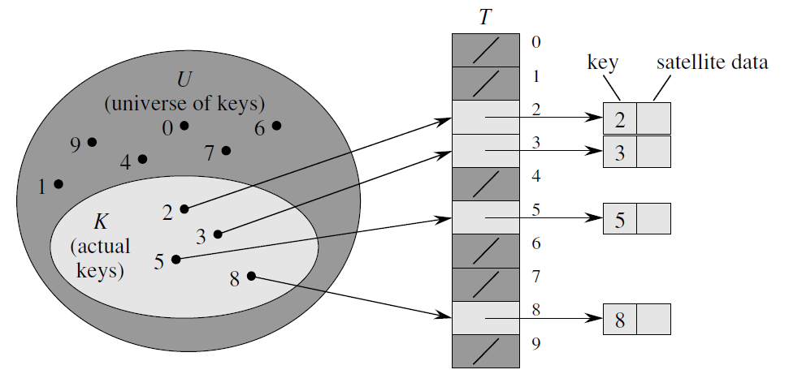
Dictionary : Using Direct Addressing
Key k is stored in slot k
Applied when the number of keys are small and are unique

Slide 9
Dictionary : Using Direct Addressing - not suitable
If the universe U is large, storing a table T of size |U| may be impractical, or even impossible, given the memory available on a typical computer.
the set K of keys actually stored may be so small relative to U that most of the space allocated for T would be wasted

Slide 10
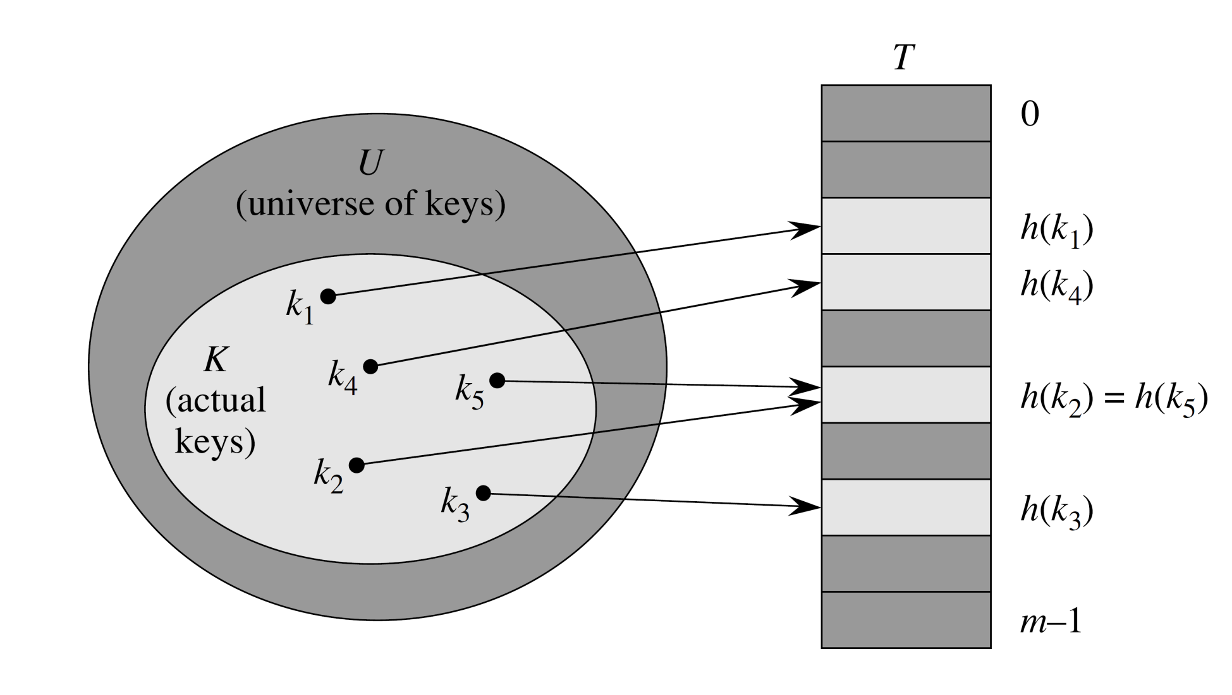
Dictionary : Using Hashing
Mapping key into the index
index = hash(key)

Slide 11
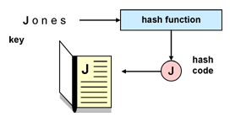
Hashing : An Example
Telephone directory

Slide 12
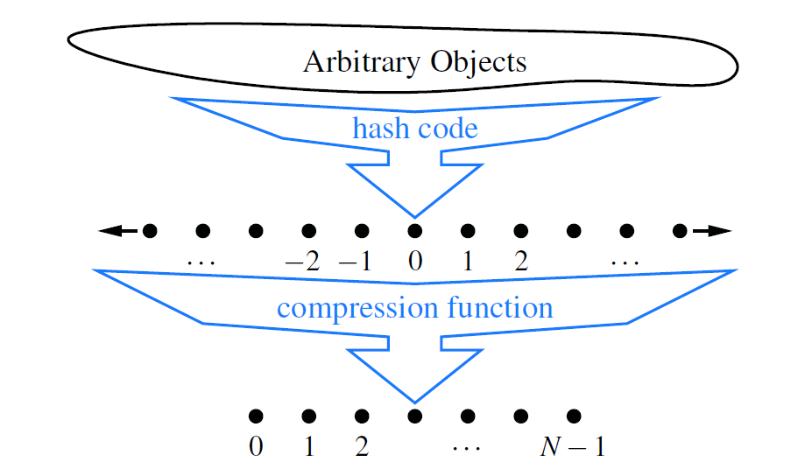
Hashing Function
key k
integer
index

Slide 13
Hash Code Maps
Bit Representation as an Integer
combine in some way the high-order and low-order portions of a 64-bit key to form a 32-bit hash code,
summation of bits
Polynomial Hash Codes
Cyclic Shift hast codes
A variant of the polynomial hash code replaces multiplication by a with a cyclic shift of a partial sum by a certain number of bits.

Slide 14
HashCode
Memory address:
interpret the memory address of the key object as an integer
Casting to an Integer
Eg: Float.floatToIntBits(x) in java
Suitable for keys whose length is lesser than that of integer
Summing the Components:
object x whose binary representation can be viewed as an n-tuple (x₀,x₁, . . . ,x_{n−1}) of 32-bit integers

Slide 15
Summing the Components
Example: Summing the ASCII codes
STOP - 83 + 84 +79 + 80 = 326
POTS - 80 + 79 + 84 + 83 = 326

Slide 16
Polynomial Accumulation
x₀a^{n−1} +x₁a^{n−2}+···+x_{n−2}a+x_{n−1}
a=33 or 37 or 39 or 41 will give at most 6 collisions on vocabulary of 50,000 words
By Horner’s rule the polynomial computation
x_{n−1}+a(x_{n−2} +a(x_{n−3}+···+a(x₂+a(x₁+ax₀)) ···)).

Slide 17
Example
x_{n−1}+a(x_{n−2} +a(x_{n−3}+···+a(x₂+a(x₁+ax₀)) ···)).
STOP (if a=33)
33*(80+(33*(79+(33*(84+(33*83)))))) = 101538822
POTS (if a=33)
33*(83+(33*(84+(33*(79+(33*80)))))) = 97806918

Slide 18
Cyclic-Shift Hash Codes
Example:
static int hashCode(String s) {
int h=0;
for (int i=0; i<s.length( ); i++) {
h = (h << 5)
h += (int) s.charAt(i); // add in next character
}
return h;
}
Example:
STOP - 2804276
POTS - 2705107

Slide 19
Cyclic-Shift Hash Codes
Example:
STOP - 2804276
POTS - 2705107

Slide 20
Hash code Excerise
What would be a good hash code for a vehicle identification that is a string of numbers and letters of the form "9X9XX99X9XX999999", where a "9" represents a digit and an "X" represents a letter?

Slide 21
Answer:
Either Summing components, Polynomial hash codes, or Cyclic Shift hash codes would be appropriate
Breaking into key consists of 6 letters and 11 digits into pieces:
break it into two groups of 3 letters, two groups of four digits and one group of three digits. five numbers or components (x₀, x₁, x₂, x₃, x₄)
- whose maximum values are 17575 (26³-1), 17575 (26³-1), 9999, 9999 and 999, respectively. For the size of our hash table, we can choose a prime number near 20000 (for example, N=19997).

Slide 22
Answer (continued)
If we use summing of components, the hash function would be
x₀ + x₁ + x₂ + x₃ + x₄ mod N
For a polynomial hash code, the hash function is
x₄ a⁴ + x₃a³ + x₂ a² + x₁ a + x₀ mod N
which can be calculated using "Horner's Rule" as
x₀ + z ( x₁ + z ( x₂ + z ( x₃ + z ( x₄ )))) mod N

Slide 23
Compression Functions
Division Method
i mod N
MAD (Multiply-Add-and-Divide) Method
[(ai+b) mod p] mod N,

Slide 24
Collision-Handling Schemes
Separate Chaining
Open Addressing
linear probing
quadratic probing
double hashing
Using pseudorandom number generator

Slide 25
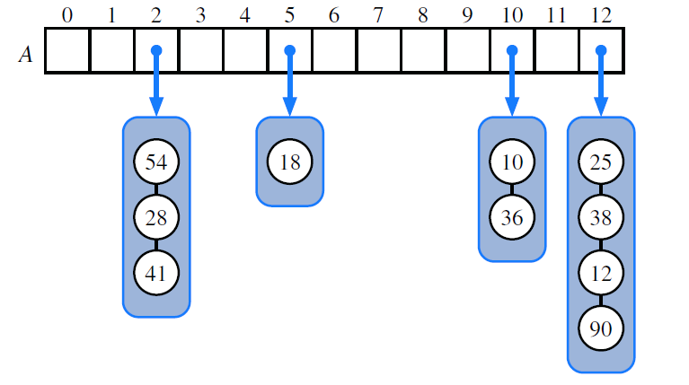
Separate Chaining
Good hash function, the core map operations run in O(⌈n/N⌉)
Where,
|λ= n/N, called the load factor of the hash table
As long as l is O(1), the core operations on the hash table run in O(1) expected time.
Figure: hash table of size 13, storing 10 entries

Slide 26
Open Addressing
This approach saves space because no auxiliary structures are employed
Open addressing requires that the load factor is always at most 1 and that entries are stored directly in the cells of the bucket array itself.

Slide 27
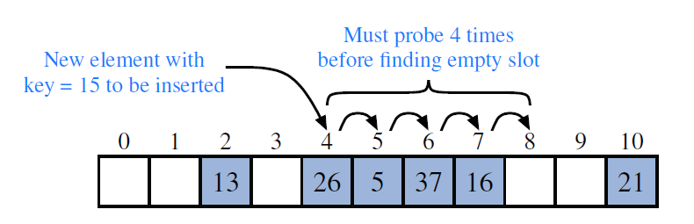
Linear Probing
hash function is h(k) = k mod 11.
Finding empty bucket
Next try A[( j+1) mod N]
where, j = h(k),
Next try A[( j+2) mod N] and so on

Slide 28
Linear Probing
get, put, or remove operations should be modified
Replace a deleted entry with a special “defunct” sentinel object to aovid
Put should remember a defunct location encountered during the search for k

Slide 29
Quadratic probing
Finding empty bucket:
A[(h(k)+ f (i)) mod N], for i =0,1,2, . . ., where f (i) =i²
Complicates the removal operation
Avoids the kinds of clustering patterns that occur with linear probing.
it creates its own kind of clustering, called secondary clustering

Slide 30
Double hashing
secondary hash function, h′,
Where h′(k) = q−(k mod q)
A[(h(k)+ f (i)) mod N] next,
for i = 1,2,3, . . ., where f (i) = i · h′(k)

Slide 31
Double Hashing example
h(k) = k mod 13 and h′(k) = 8 – (k mod 8)
h(k) = k mod 7 and h′(k) = 5 – (k mod 5)
A[(h(k)+ f (i)) mod N] next,
for i = 1,2,3, . . ., where f (i) = i · h′(k)

Slide 32
Exercise
Draw the 11-entry hash table that results from using the hash function, h(i) =(3i+5) mod 11, to hash the keys 12, 44, 13, 88, 23, 94, 11, 39, 20, 16, and 5, assuming collisions are handled by chaining.

